Slide 1

Timothy Anthony Shawn Henrik

Slide 2
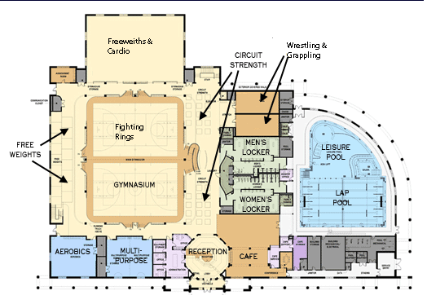
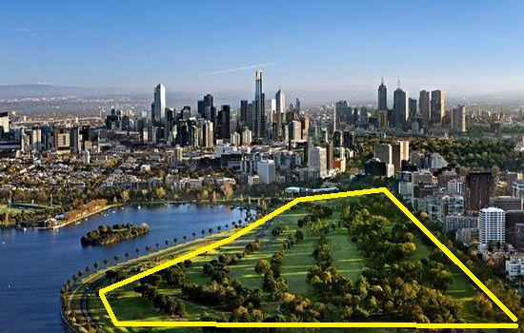
The Super Gym™

Slide 3

Super Gym™ Advantage
Introducing a high quality sports complex
Bringing 5 popular branches of sport
Introducing new talents in sports that can represent TASH and Australia
A Facility that runs by athletes and knows the need of athletes

Slide 4
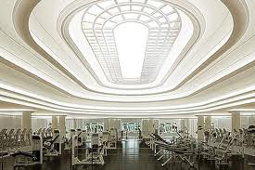
One Gym to Rule Them All
Made by the best materials and top class quality
Bringing professionals to teach and mentoring.
Bringing 5 High demands sports in one building
  Swimming , Grappling mats (Wrestling , Judo) , Fighting rings (Boxing , Muai Thai)
Sponsorship for the high performance athletes
Paying extra attention to the new talent

Slide 5
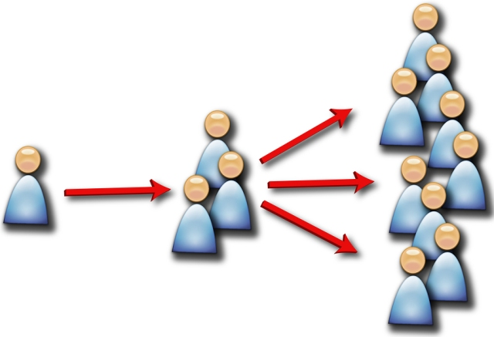
Reaching our customers

Slide 6


What We Need?
Your involvement!
Money – around $3.6 million to get started
  - This includes cost of land, buildings, initial marketing and all other costs required for start up!

Slide 7
Will You See A Return?
Yes! Our estimates and calculations show that TASH will be making a sizable profit after the first year of operation
Income will be generated mainly through membership fees, but also from;
  Personal training sessions
  Meals
  Workout supplements

Slide 8
After The First Year

Slide 9
Thank you!

